Slide 1
Self-balancing Trees
Unit 6
CPRG304 – Object-Oriented Programming III

Slide 2
Balanced Trees
As you have seen, the performance of a tree is dependent on whether it is balanced
  Ill-balanced: O(n)
  Balanced: O(log n)
But every insertion and deletion operation will affect the balance of a tree
Thus we want to make sure the balance of the tree is maintained after each operation
  Height of tree is keep to a minimum

Slide 3
Balancing a Tree
2 approaches:
  Deconstruct the tree by aligning the nodes in an array and sort them using one of the efficient algorithms
    Easy to implement
    Inefficient space-wise, also requires deconstructing and then reconstructing the tree = time-consuming!
  Use a “self-balancing” tree algorithm
    Much less wasteful than the first approach
    Requires each node to maintain a reference to its parent (small trade-off)
    Automatically re-balances the tree after each operation if needed
Notes:
Or in A3 you can write the tree out using the in-order iterator and rebuild at minimum height.

Slide 4
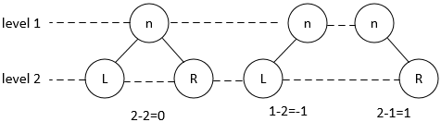
Balance of a Node
The balance of a node is the height of the right sub-tree minus the height of the left sub-tree:
Balance(n) = right-height(n) - left-height(n)
  Where n is some node in the tree
Notes:
or left – right: doesn’t matter, we just need to know the difference!

Slide 5
Balance of a Node
It’s important to identify the balance of each node to determine if the tree is balanced
0
-1
+1
0
0
0
0
Notes:
Any -1 can be treated as +1, the sign does NOT matter here!

Slide 6
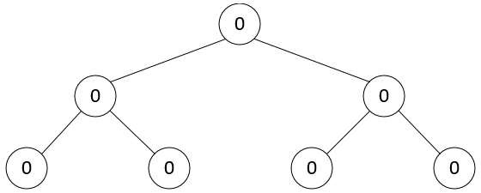
Balance of a Node
-2
-1
-2
-1
0
0
1
0
0
Notes:
Same as before, the sign doesn’t matter! -2 == +2. -1 == +1.
As long as the number is >1, then the node is not balanced!

Slide 7
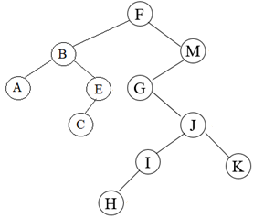
Exercise
What is the balance of each node?
Notes:
A, C, H, K (leave nodes) = 0
Going from bottom-up, left to right:
I = 1
J = 1
E = 1
G = 3
B = 1
M = 4
F = 2

Slide 8
AVL Trees
Definition: a binary search tree where every node has a balance of -1, 0, or 1
  Named after the inventors G. M. Adel’son-Vel’skii and E. M. Landis, who developed the idea in 1962
  First self-balancing tree invented
  If the tree is not balanced after an operation, re-balance the BST
Uses an idea called Rotations
  Changing the relationships between nodes
Notes:
“self”-balancing = “programmed” to re-balance = done by us!

Slide 9
AVL Insertions
An AVL tree is a form of BSTs so insertion operations are exactly the same
  Recall BSTs:
    All nodes in the left subtree, if not empty, contains elements less than or equals to the node element
    All nodes in the right subtree, if not empty, contains elements greater than the node element
  Recall BST Insertions:
    To insert a new element into a BST, proceed as if searching for that element
Since AVL are “self-balancing”, the key is what happens after an insertion operation!

Slide 10
The Pivot Node
First step of rotations!
  AVL trees adjusts the nodes based on the nature and position of the pivot node!
Definition: the ancestor node closest to the inserted node which is not in balance
  i.e. not 0, -1, or +1
Identify the balance of each node bottom-up from the inserted node
  It is possible that there are no pivots after an operation
Notes:
Start with the new node and calculate the new balances of each ancestor node (parent, grandparent etc.)

Slide 11
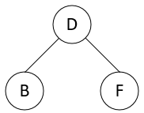
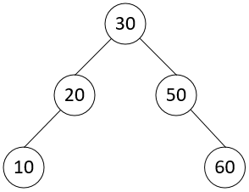
Pivot Examples
Add A: Add 5:
Notes:
Add A: No pivot (still balanced)
Add 5: pivot = 20

Slide 12
Pivot Identification Exercise
What would the pivot be for each of the following insertions using this tree as the starting point?
5, 27, 41, 70
40₋₁
30₋₁
50₀
20₀
35₀
45₀
60₀
10₀
25₀
Notes:
For 5 and 27 the pivot would be 30.
For 41 and 70 there would be no pivot.

Slide 13
The Other Nodes
The rest of the nodes are defined in relations to the pivot
  Ancestor/grandparent: parent of pivot
  Son: children of pivot
  Grandson: children of son
  Great-grandson: children of grandson
  Etc.
We will also need to differentiate the 2 possible children of each node
  Good son: the child unaffected by the inserted node
  Bad son: the child with the inserted node as its descendant
    Same goes for grandson and great-grandson
Notes:
Unaffected = balance did not change after adding the new node.

Slide 14
Rotations
After identifying the pivot and the other related nodes, we must determine the structure of the AVL tree to perform the correct rotation to “re-balance” the tree
4 rotational cases:
  Left-left – single rotation
  Right-right – single rotation
  Left-right – double rotation
  Right-left – double rotation
Notes:
It’ll be very obvious why they’re called these when you see it!

Slide 15
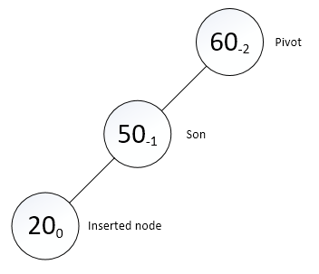
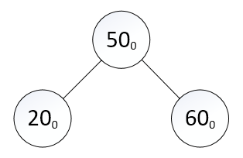
Left-Left Case
From the pivot, we travel down the left subtree to the bad son, then left subtree again to the bad grandson
  Perform a right rotation: the pivot “rotates” down to become the right child of bad son, bad son replaces pivot’s position, all other nodes are unchanged
  Before: After:

Slide 16
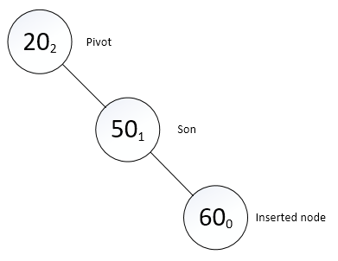
Right-Right Case
From the pivot, we travel down the right subtree to the bad son, then right subtree again to the bad grandson
  Perform a left rotation: the pivot “rotates” down to become the left child of bad son, bad son replaces pivot’s position, all other nodes are unchanged
  Before: After:

Slide 17
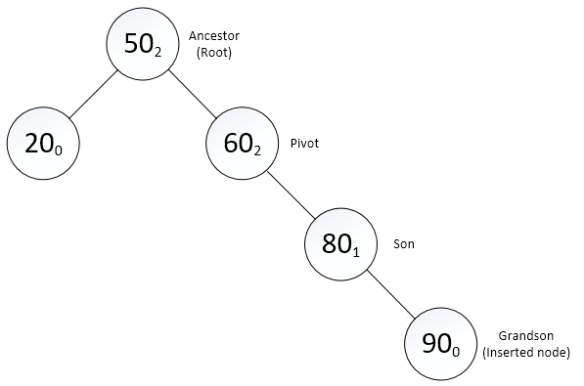
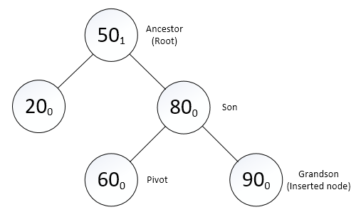
Another Example
Before: After:
Notes:
Note that 20 is unchanged and remains the left child of 50.

Slide 18
Exercise
Start with an empty tree, add 55, 43, 27 and make notes of node balances after each insertion
Identify pivot, son and grandson
Perform the correct rotation
Add 68, 82 and rotate again
What is the resulting AVL tree?
Notes:
https://visualgo.net/en/bst, click on “AVL tree” tab and check your answers!

Slide 19
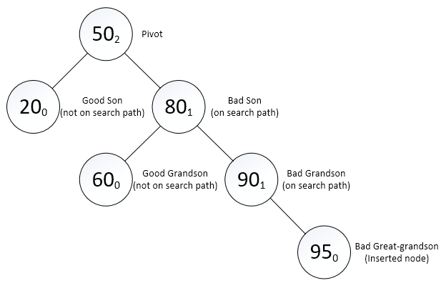
Single Rotations with Subtrees – Before rotation
Right-right case
  From pivot, search path towards inserted node
  Bad son/grandson: balance changed after insertion
  Good son/grandson: balance unaffected
Notes:
Still follow the same rules to do a left rotation – pivot will rotate to be the left child of bad son, but it already has a left child, what do we do with it?
- reminder: AVL is still BST! Note the value 60 is greater than pivot 50!

Slide 20
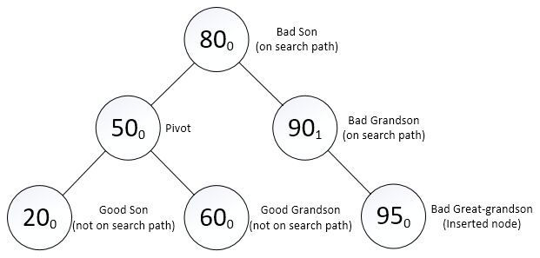
Single Rotations with Subtrees – After rotation
Left rotation
  Pivot takes good son and “adopts” good grandson to form a new left subtree of bad son
Notes:
Note that 20 is unchanged and remains the left child of 50, and 90/95 remains on the right subtree on 80.

Slide 21
Exercise
Start with an empty tree, add 60, 40, 80, 20, 50 and make notes of node balances after each insertion
Add 10 and identify pivot, sons, grandsons and great-grandsons
Perform the correct rotation
Add 70, 85, 95 and rotate again
What is the resulting AVL tree?

Slide 22
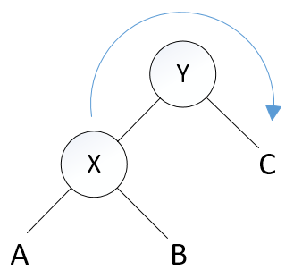
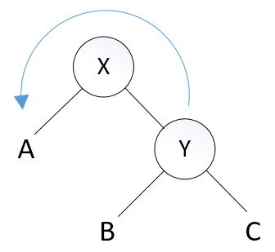
General Rotation Rule
The B subtree is rotated with the pivot to maintain the strict order of BSTs
Right
Left
Notes:
B subtree is greater than X but less than Y. A and C remains unchanged.

Slide 23
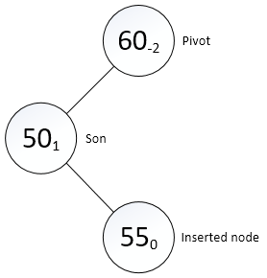
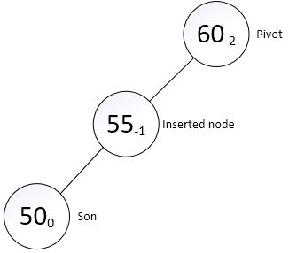
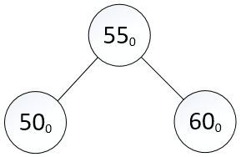
Left-Right Case
From the pivot, we travel down the left subtree to the bad son, then right subtree to the bad grandson
  Perform a left rotation on son: make it into a left-left case
  Perform a right rotation on pivot
Notes:
After 1st rotation, it may help to recalculate balances and rename the nodes – so son becomes bad grandson, and new node is now bad son.

Slide 24
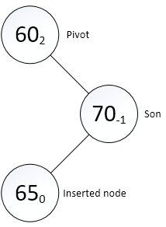
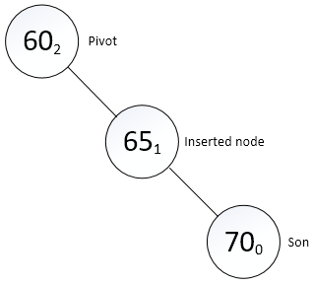
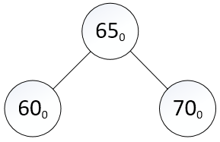
Right-Left Case
From the pivot, we travel down the right subtree to the bad son, then left subtree to the bad grandson
  Perform a right rotation on son: make it into a right-right case
  Perform a left rotation on pivot
Notes:
After 1st rotation – son becomes bad grandson and new node becomes bad son.

Slide 25
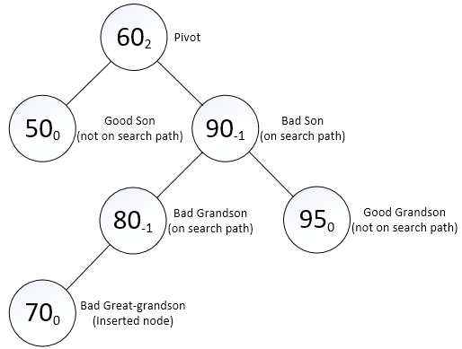
Double Rotations with Subtrees – Before rotation
Right-left case
  1st rotation: convert into right-right case by rotating bad grandson up to be the parent of bad son

Slide 26
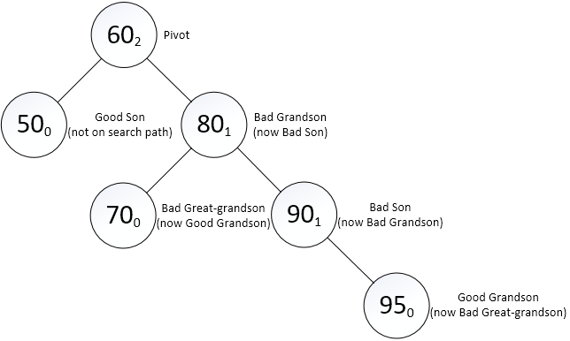
Double Rotations with Subtrees – After 1st rotation
Right-right case
  2nd rotation: pivot takes good son and good grandson to form new left subtree of bad son

Slide 27
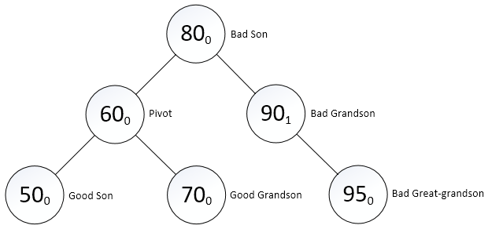
Double Rotations with Subtrees – After 2nd rotation
Notes:
Insert 60,50,90,80,95,70 into “create empty” on visualgo

Slide 28
AVL Deletions
Works exactly like BST deletion operations
  Using either the “next smaller” or “next bigger” approach
  Must keep the tree balanced after removing a node!
Just like insertions, recalculate the balances of each node, identify the pivot if any and rotate according to the structure
  We won’t cover this in the course, but if you’re interested – try out the “remove” function on visualgo.net! :D

